Slide 1
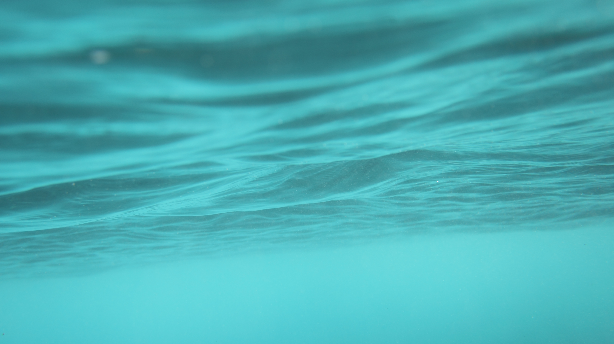
Mayday!Mayday!
Dr Michael Underdown

Slide 2
JCU 2024 Law Seminar Series
Collision
Scuttling
Wreck
Ship Arrest

Slide 9
The fishing vessel Alfred, skippered by Tony Philippson, collided with the 85 m barge Seatow 17 at 0455 at Port Tarakohe on 16 October 2002.
Seatow 17, towed by a tug, arrived at Port Tarakohe the previous evening and was advised by the Port Manager not to anchor across the lead lights as the next morning was the start of the scallop season and the fleet of 54 boats would be departing at first light.
Despite these instructions, the skipper of the tug decided to anchor across the lead lights, with the tug on the offshore side of the barge, so the tug crew could observe the barge from the pub verandah.

Slide 10
F/V Alfred was the 5th boat to sail. Two of the 4 earlier boats did not see the barge because it was only displaying one of the required 2 anchor lights.
The skipper of the F/V Alfred turned around briefly to put on a kettle moments before she hit the barge and sank while he was calling Maritime Radio.
The skipper and one crew member were rescued by the F/V Silver Foam, but the other crew member drowned when his leg was caught in a rope and he was dragged under when the boat sank.

Slide 11
At the outset I played a WAV file of the distress call (mayday call) made by the skipper of the F/V Alfred following her collision with the dumb barge Seatow 17.
NZ Maritime Radio operates a continuous listening watch. The distress call was picked up by the site at d’Urville Island in Marlborough Sound.
One of the first things an experienced maritime lawyer will do after a collision is obtain a WAV file from Maritime Radio of any messages. This usually will give the precise location of the vessels involved.

Slide 12
At first the barge owners tried to claim they had anchored to one side of the lead lights where there are designated anchorages in the New Zealand Pilot.
I acted for the insurer of the F/V Alfred, Sunderland Marine Mutual Insurance Company, and was able to demonstrate that the owners were lying about both their position and the fact that the barge was not properly lit. We reached a settlement with the owners, who paid for all the losses without admitting liability.
The Maritime Safety Authority (MSA) prosecuted the skipper for breaches of the COLREG and the Coroner undertook a coronial inquest because of the death of one of the deckhands.

Slide 13
The MSA charged the skipper with failing to keep a proper lookout and failure to display the standards of a “reasonably competent skipper”. Rule 5 of the COLREG states “Every vessel shall at all times maintain a proper look-out by sight and hearing…”
The skipper could not pick up the barge on the radar and the expert I called gave evidence that this was probably due to a combination of using the “Anti Sea Clutter” gain control more than necessary and the shape of the cliff at Port Tarakohe.
The skipper was fined $2,000 and ordered to pay $8,000 reparation to the family of the drowned crew member. Incidentally, one of the skipper’s brothers had been lost at sea in 1996.

Slide 14
At the inquest, the Coroner was critical of the fact that the MSA had not laid charges against the owner of the barge.
In 2007, Tasman District Council’s bylaws regulating navigation safety were updated in an effort to prevent similar incidents.
There were two sequels. The same Seatow barge and tug (but with a different tug skipper) were responsible for the deaths of 4 recreational fishers at Carnarvon on 18 March 2007 when they also failed to properly illuminate the barge and in 2022 the skipper of the F/V Alfred was again prosecuted for failing to maintain a proper lookout after the F/V Mistral ran aground while he was asleep.

Slide 16
Scuttling
On 27 October 2004, the F/V San Rochelle caught fire and sank 97 nautical miles north of Cape Reinga.
This is a case where the official Marine Occurrence Report produced by TAIC (the NZ Transport Accident Investigation Commission) is not completely accurate. Both I, as the lawyer acting for Sunderland Marine Mutual Insurance Company, the insurer of the boat, and the Maritime Safety Authority, established other facts.

Slide 18
Normally, if an insurer suspects that the assured is committing fraud, the easiest thing to do is simply to refuse to pay out on the claim. The onus is then on the aggrieved party to take legal action or simply walk away – as happened here.
Usually, the 2 biggest costs for a commercial fisher are fuel costs and crew costs. At the time of this incident, marine fuel costs were increasing rapidly in New Zealand and there was an increase in cases of scuttling.
This is assisted by the practice in marine insurance of insuring boats for an agreed value rather than a depreciating value.

Slide 19
I will now summarise what happened and then look at what TAIC was not told by the F/V San Rochelle’s owner.
The F/V sailed from Auckland on 24 October 2005 with the skipper and 2 deckhands on board.
At 0115 on 27 October, the crew began attaching the hook snoods to the longline as it was paid out. At 0345, while setting the gear was still taking place, the skipper noticed smoke coming from the engine room.
4 minutes later the skipper made a distress call and 40 minutes later the crew got into the liferaft.

Slide 20
At 0500 the skipper also abandoned ship, rowing a small dinghy to the liferaft.
A RNZAF Orion flew over the F/V San Rochelle around 0800 and about 2 hours later a Westpac rescue helicopter winched the survivors from the liferaft.
Another fishing vessel, F/V St Paul, arrived at the site about 1400 but the F/V San Rochelle had sunk and there was no sight of flotsam or the liferaft and dinghy.
Now, what additional facts came to light?

Slide 21
Commercial fishermen tend to talk a bit in pubs, so that was the first place for me to make enquiries. I discovered that the skipper had left a long-time crew member behind. He had also only taken on board enough fuel for 2 days, whereas the usual duration for a fishing trip was 6 days.
I was able to interview the extra deckhand who was on board, a Scottish tourist who just happened to be on the wharf looking at the boats. The skipper asked him if he would like to go on board; he thought just for a quick spin around the harbour. He told me the closest he had ever been to a boat was seeing lobster creels on a wharf when he was a kid.

Slide 22
It is important to note that, if the F/V San Rochelle had sailed 3 nautical miles further from the coast, she would have required an additional crew member and different qualifications.
The skipper had completed a maritime fire fighting course shortly before the incident and had also recently changed his Safe Ship Management provider.
The colour of the smoke, as observed by the deckhands, did not support a fuel fire.
Finally, when the skipper abandoned the boat, he took with him a rifle but failed to take the log or any other ship’s papers.

Slide 23
All of these facts, taken together, aroused suspicion that this was a scuttling incident. One can only speculate about what the skipper intended to do with the rifle.

Slide 24
Wreck
This case concerns the attempted removal of a wrecked yacht.
On 5 March 2003, the yacht Ruru sank in approximately 52 metres of water 6.5 nautical miles east of Farewell Spit lighthouse while underway from Picton to Australia.
On 15 May 2003 the Harbourmaster of Tasman District Council wrote to the owner, an Australian medical practitioner, asking him to remove the wreck.
His response, through his lawyer, was that the wreck posed no hazard to navigation.

Slide 27
In New Zealand the primary legislation now dealing with wreck removal is found in Maritime Transport Act 1994.
Section 33J authorises Regional Councils to remove and deal with any wreck that is a hazard to navigation.
Tasman District Council is a unitary authority performing the function of a Regional Council.
The maritime jurisdiction of Regional Councils (‘coastal marine area’) extends to the outer limit of the territorial sea, which extends 12 nautical miles seaward from the low water mark.

Slide 28
The wreck of the Ruru therefore lay within Tasman District Council’s jurisdiction.
A Council may either require the owner of the wreck to remove it or may itself destroy, remove or sell the wreck, and if sold, may recover its expenses from the sale proceeds.
At the time of the sinking of the Ruru, the harbourmaster believed that the wreck posed a hazard to navigation because commercial fishing took place in the vicinity of the wreck and there was “significant risk” of the wreck snagging trawl nets and even causing failure of equipment such as winches if a net was snagged.

Slide 29
The owner’s lawyer argued that the depth at which the wreck lay meant it did not pose a hazard to navigation.
The Nairobi International Convention on the Removal of Wrecks (2007) has now entered into forces and Art 6 provides an extensive list of criteria for determining a hazard.
Prior to this, the depth of water was only one criteria. Other important factors were the proximity of the wreck to shipping routes and the possibility of it endangering or preventing the passage of a vessel. Admiralty charts generally consider a wreck in less than 28 metres of water a hazard.

Slide 30
In light of the fact that the owner of the Ruru was not inclined to take any action – which is often the case with smaller wrecks – Tasman District Council was put to the choice of removing the wreck itself or at least rendering it less likely to pose a problem and then attempting to recover its costs from overseas.
I am not certain what ultimately occurred because I subsequently moved to Clayton Utz in Perth, where I had a completely different type of maritime and port practice, but perusal of the Tasman District Council’s Annual Reports show that they regularly remove wrecks.

Slide 31
Ship Arrest
On 5 July 2003 one of New Zealand Rail’s Interislander ferries collided bow first with the F/V San Domenico moored at Aotea Quay in Wellington Harbour (actually tied up on the order of the Ministry of Fisheries for fishery offences).
The F/V San Domenico suffered extensive damage as did the massive jarrah piles of the wharf.
I was actually attending a conference at Victoria University at the time and was instructed by Sunderland Marine Mutual Insurance Company to go and inspect the damage myself as they insured the F/V San Domenico.

Slide 35
The first thing I did when I arrived at Aotea Quay was to inspect the F/V San Domenico. The 3 crew were on board when the collision occurred; the skipper lived in Wellington and had gone home.
I noticed that there was a camera fixed to a building on the wharf and asked the harbourmaster if I could see the footage. It was quite alarming to see the bow of a much larger vessel ploughing straight for the F/V San Domenico.
At any one time, there are 2 Interislander ferries operating, one heading south to Picton and the other sailing north to Wellington. These ferries carry not only people, but also trains, trucks and cars.

Slide 36
On this particular Saturday, the northbound ferry Arahura was running late because of bad weather in the Cook Strait and the master of the southbound ferry Aratere left the terminal to allow the Arahura to berth. However, the two masters arranged that the Aratere would re-birth at the ferry terminal once the Arahura had discharge its passengers and cargo.
As the Aratere was making its 3-point turn – as I believe from viewing the camera footage, not at a safe speed (although the TAIC Marine Occurrence Report does not mention this, but instead refers to the master’s “chronic sleep loss” as a cause – it collided with the F/V San Domenico and then grazed another moored fishing vessel, the F/V San Liberatore.

Slide 37
We immediately filed proceedings in Admiralty in the High Court of New Zealand against the Aratere, her American owner and Tranz Rail as the bareboat charterer of the ship. We sought $900,000 in losses, made up of the actual total loss of the F/V San Domenico and associated costs arising from the collision (scrapping at sea due to the fibreglass hull of the boat).
The owners undertook, through their marine insurers and underwriters to provide security to the High Court in the amount of $5,100,000 plus interest and costs or to pay that sum into court.
Normally in cases of ship arrest the marine insurers and their underwriters in Zurich and Munich and elsewhere reach agreement on these undertakings within 24 hours because demurrage (delay in port) can often cost well over USD 50,000 a day.

Slide 38
In this case, there was added pressure. Even though the service between Wellington and Picton had been temporarily suspended due to bad weather in Cook Strait, the Aratere was fully booked with passengers for the first day of the school holidays plus its usual rail and vehicle cargo.
Once lawyers receive an undertaking, they file the necessary documents to have the ship released from arrest. In this case, the matter did not proceed further as the owners of the San Domenico settled with Wilmington Trust Company (the Aratere’s US owner) and TranzRail.

Slide 39
Conclusion
In conclusion, I would just like to state that I have focussed on a few cases from my early days as a maritime lawyer – often acting for Sunderland Marine Mutual Insurance Company, the largest insurer of commercial fishing in the world, because they illustrate the types of work undertaken by a specialist in “wet” shipping – collisions, wrecks, salvage, towage, ship arrest and so on. Lawyers working in “dry” shipping focus on cargo claims.
In addition, my subsequent work in maritime law at Clayton Utz was for the RAN and other Government clients as well as for much larger companies than fishing companies and overseas clients.

